Slide 1
Movie Recommendation Using Metadata Based Word2Vec Algorithm Yeo Chan Yoon ; Jun Woo Lee PlatCon 2018, South Korea
報告者：陳克威
日 期：2019/09/24

Slide 2
Word2Vec
The dog barked at the mailman.
[‘The’, ‘dog‘, ’barked’, ‘at’] (window = 2)
(input word, output word)
(‘dog’, ‘barked’)，(‘dog’, ‘the’) (skip_num = 2)

Slide 3
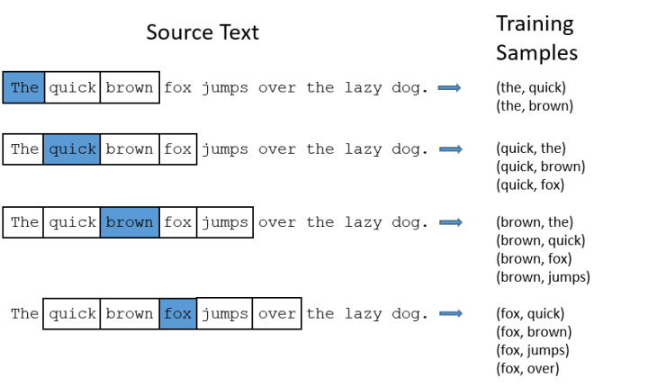
Word2Vec

Slide 4
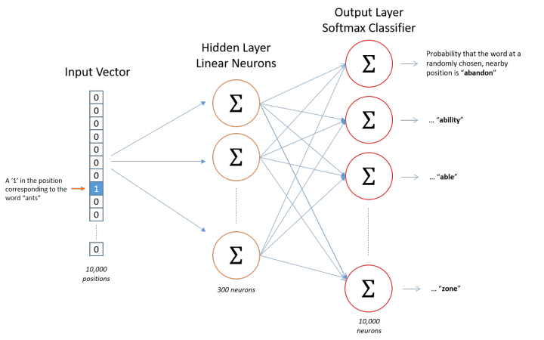
Word2Vec
Notes:
1 x 10000
10000 x 300
300 x 10000
算loss function , gradient descent, back propagation

Slide 5
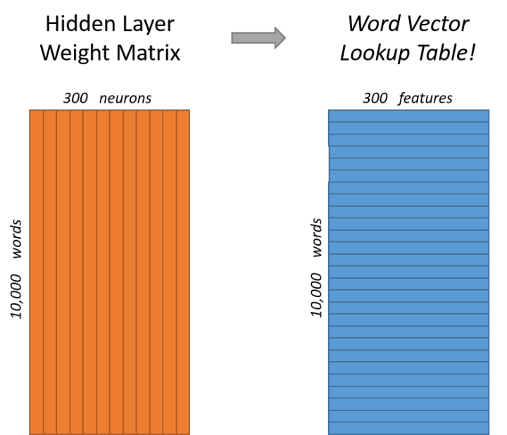
Word2Vec

Slide 6
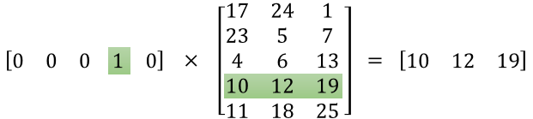
Word2Vec
1 x 5 5 x 3 1 x 3

Slide 8
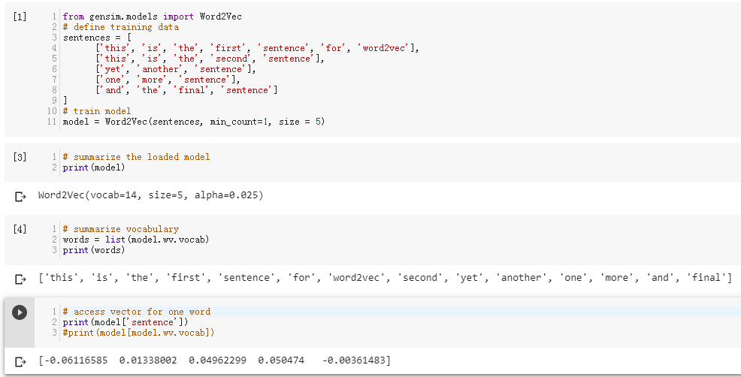
範例

Slide 10
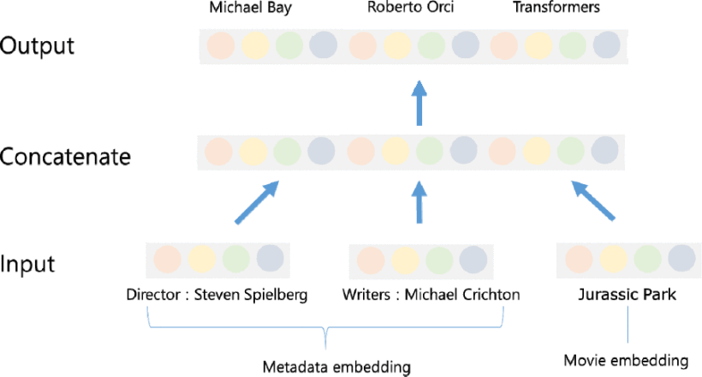
Proposed Method
The proposed method exploits various metadata of movie, such as movie director, actor, production year, production cost, movie tag and so on.
Values of these metadata are embedded as vector and are used as input and output of proposed Word2Vec network.
Movie embedding is also used as input and output with meta data embedding.
Notes:
一部電影當input ， 另一部電影當output

Slide 11

A. Training Embedding of Each Movie
The input and output pairs can be obtained from the user's movie purchase and viewing history data.
For example, if a user watches four movies A, B, C, D and assigns five, two, five and five rating to each movie, the pairs of movie (A and C), (A and D) and (C and D) are set to positive examples which are used to train the Word2Vec network.

Slide 12
A. Training Embedding of Each Movie
The movie and metadata vectors given as inputs are initialized with pretrained embedding using the Word2vec algorithm.
1. The movies rated highest score by the same user, pairs of metadata included in the movies are used as input and output of the Word2Vec network.
2. If a movie contains two tags (#Smooth, #Romantic), it is used as training example.

Slide 14
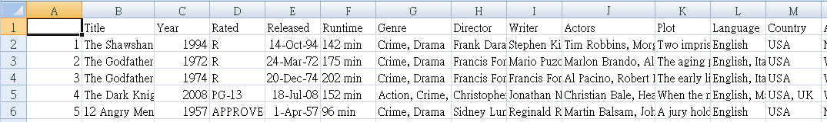
IMDB Top 250 Movie

Slide 16
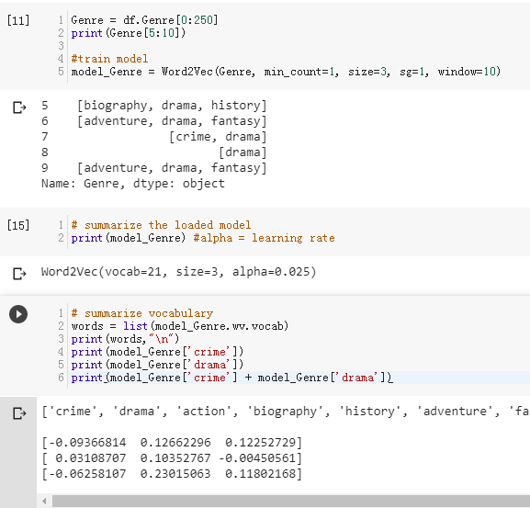
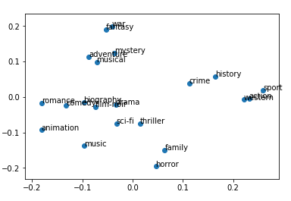
Notes:
每個Genre被轉成3維的向量
PCA 轉 2D

Slide 17
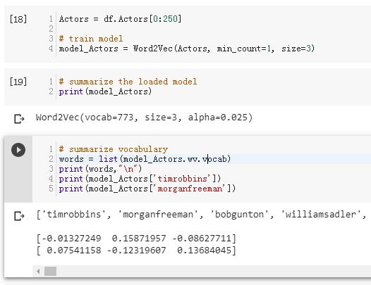

Slide 18

B. Prediction of User Vector
viewing time of the user u
of the i-th movie.
user u's latent vector
vector of the i-th movie

Slide 19
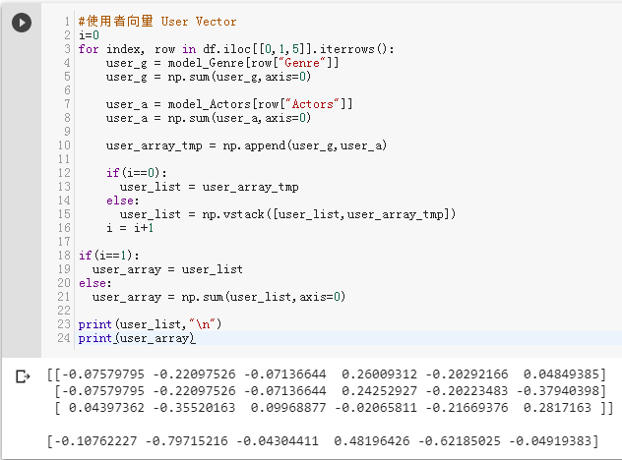

Slide 20
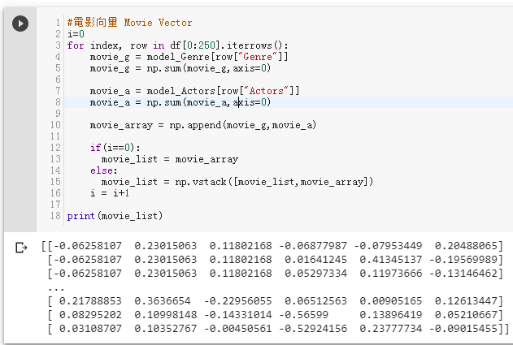
Notes:
250 x 6

Slide 21
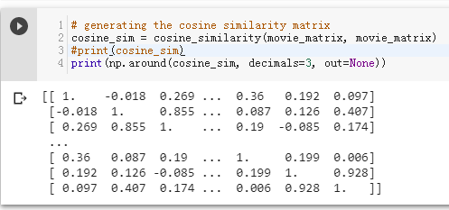
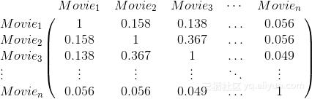

Slide 22

C. Generation of Recommend List
In this paper, we use the inner product of the item vector and the user vector in order to rank the movies for each user.
predicted rating for the movie i of user u
average rating of the movie u
average rating of the entire movie
average rating of the movie i
Notes:
預測User對item的rating
全部item的平均rating
此user對item的平均rating
這個item的平均rating

Slide 23
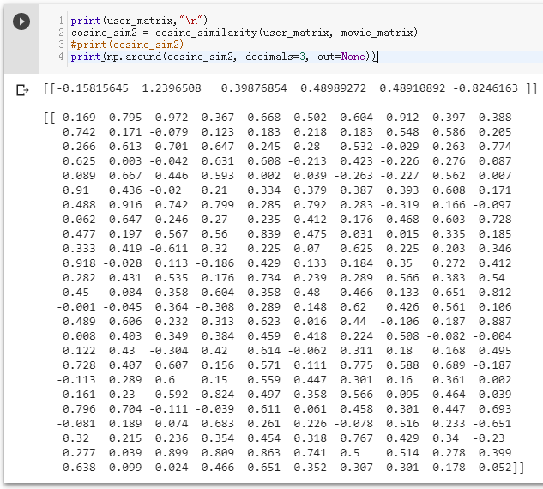
Notes:
算cos_sim

Slide 24
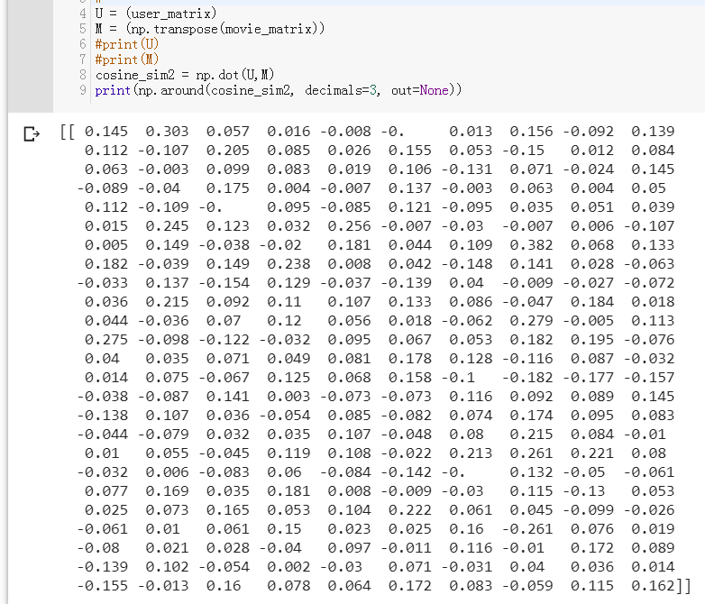
Notes:
算內積

Slide 26
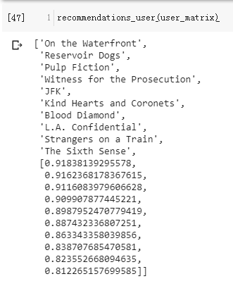
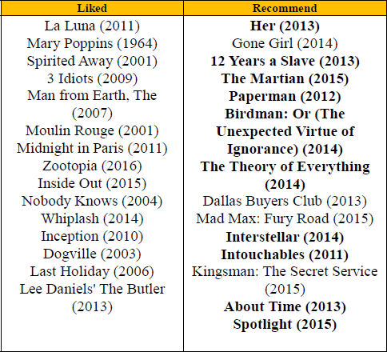
B. Experimental Result
粗體 表示用戶對推薦結果滿意

Slide 27
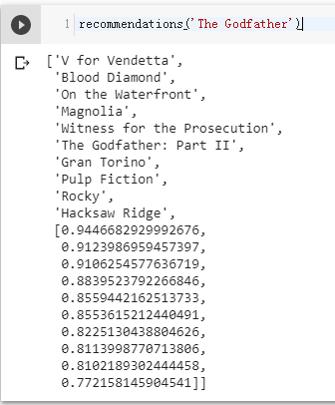
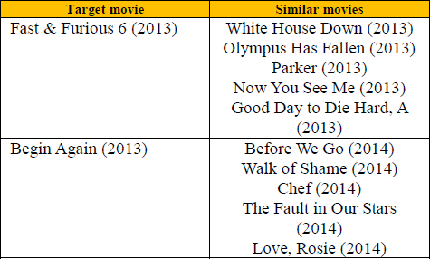
B. Experimental Result

Slide 29
Thanks for listening.
報告者：陳克威
日 期：2019/09/24

